Slide 1
IDI-9011 Drill Extension
user’s manual 正確安裝說明
Freddie Lin
Sept 28, 2010

Slide 2
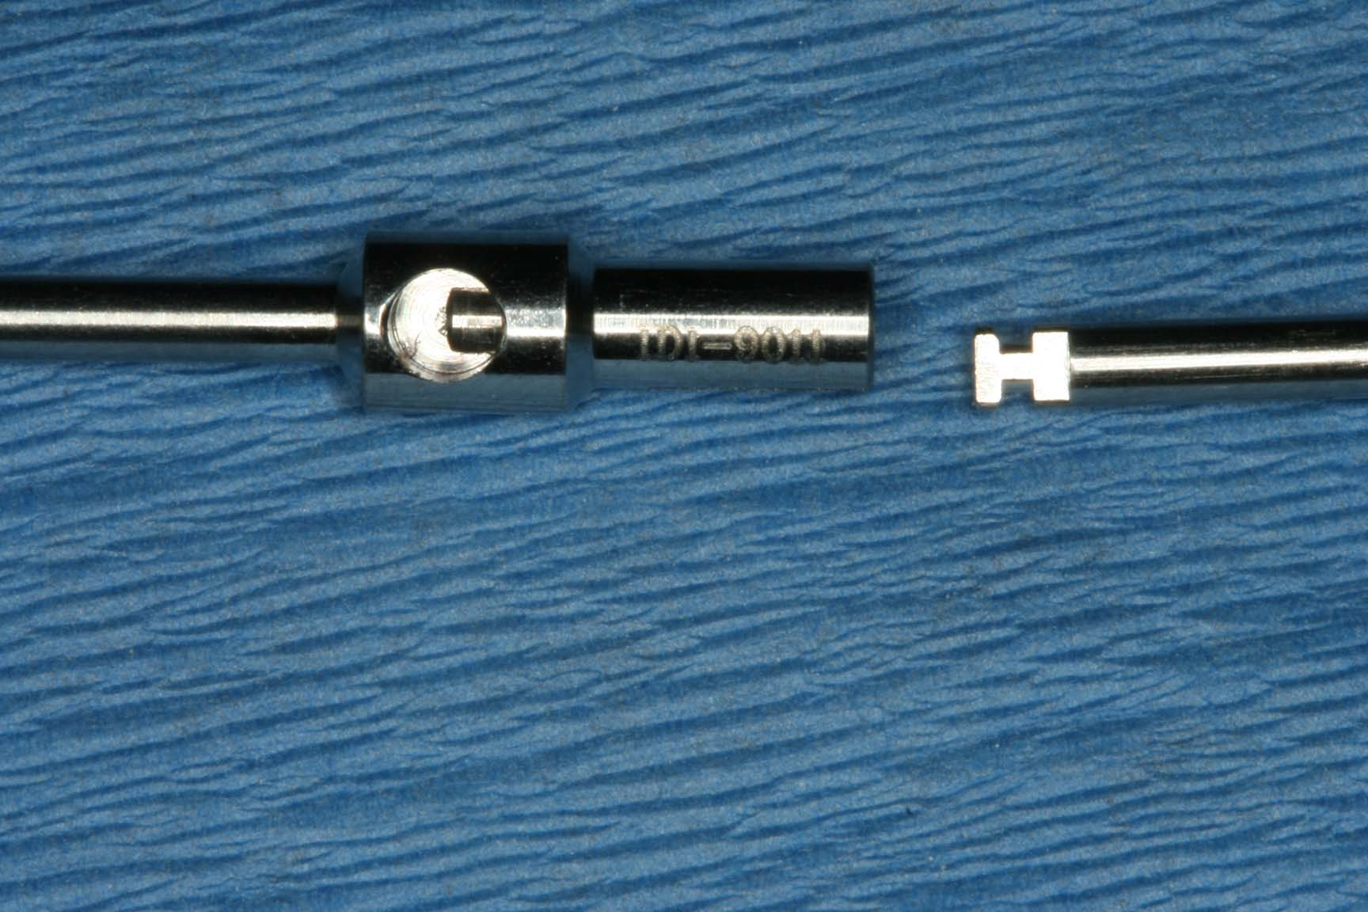
IDI-9011 Drill Extension User’s Manual 正確安裝說明
Step 1
Put IDI-9011 Drill Extension’s semi-circular slot and Drill’s flat end facing yourself.
請將IDI-9011鑽頭延長上的圓孔及鑽頭尾端的平面端面對自己。
Semi-circular slot
flat end of drill

Slide 3
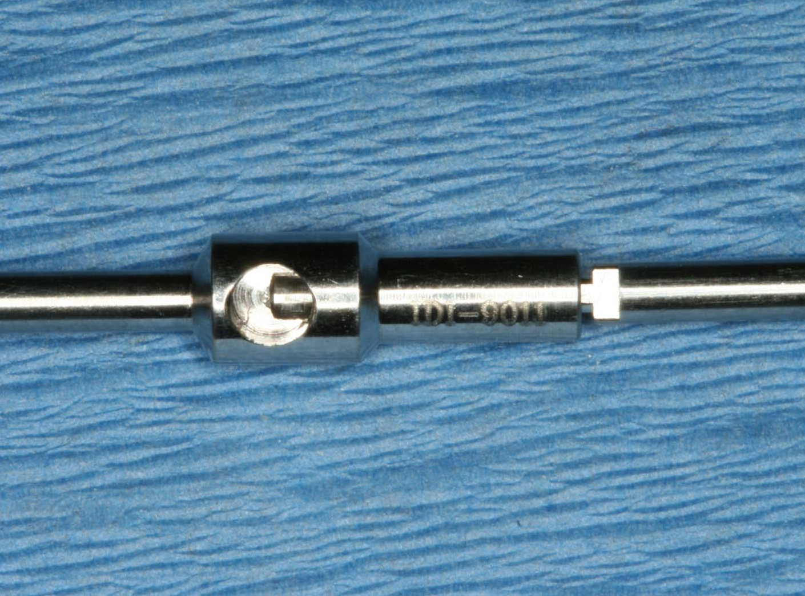
IDI-9011 Drill Extension User’s Manual 正確安裝說明
Step 2
When seating drill into IDI-9011 Drill Extension, DO NOT twist nor spin both instruments, keep IDI-9011 Drill Extension’s semi-circular slot and Drill’s flat end facing yourself.
連接IDI-9011鑽頭延長及鑽頭時，請勿轉動。持續將IDI-9011鑽頭延長上的圓孔及鑽頭尾端的平面端面對自己。
Semi-circular slot
flat end of drill

Slide 4
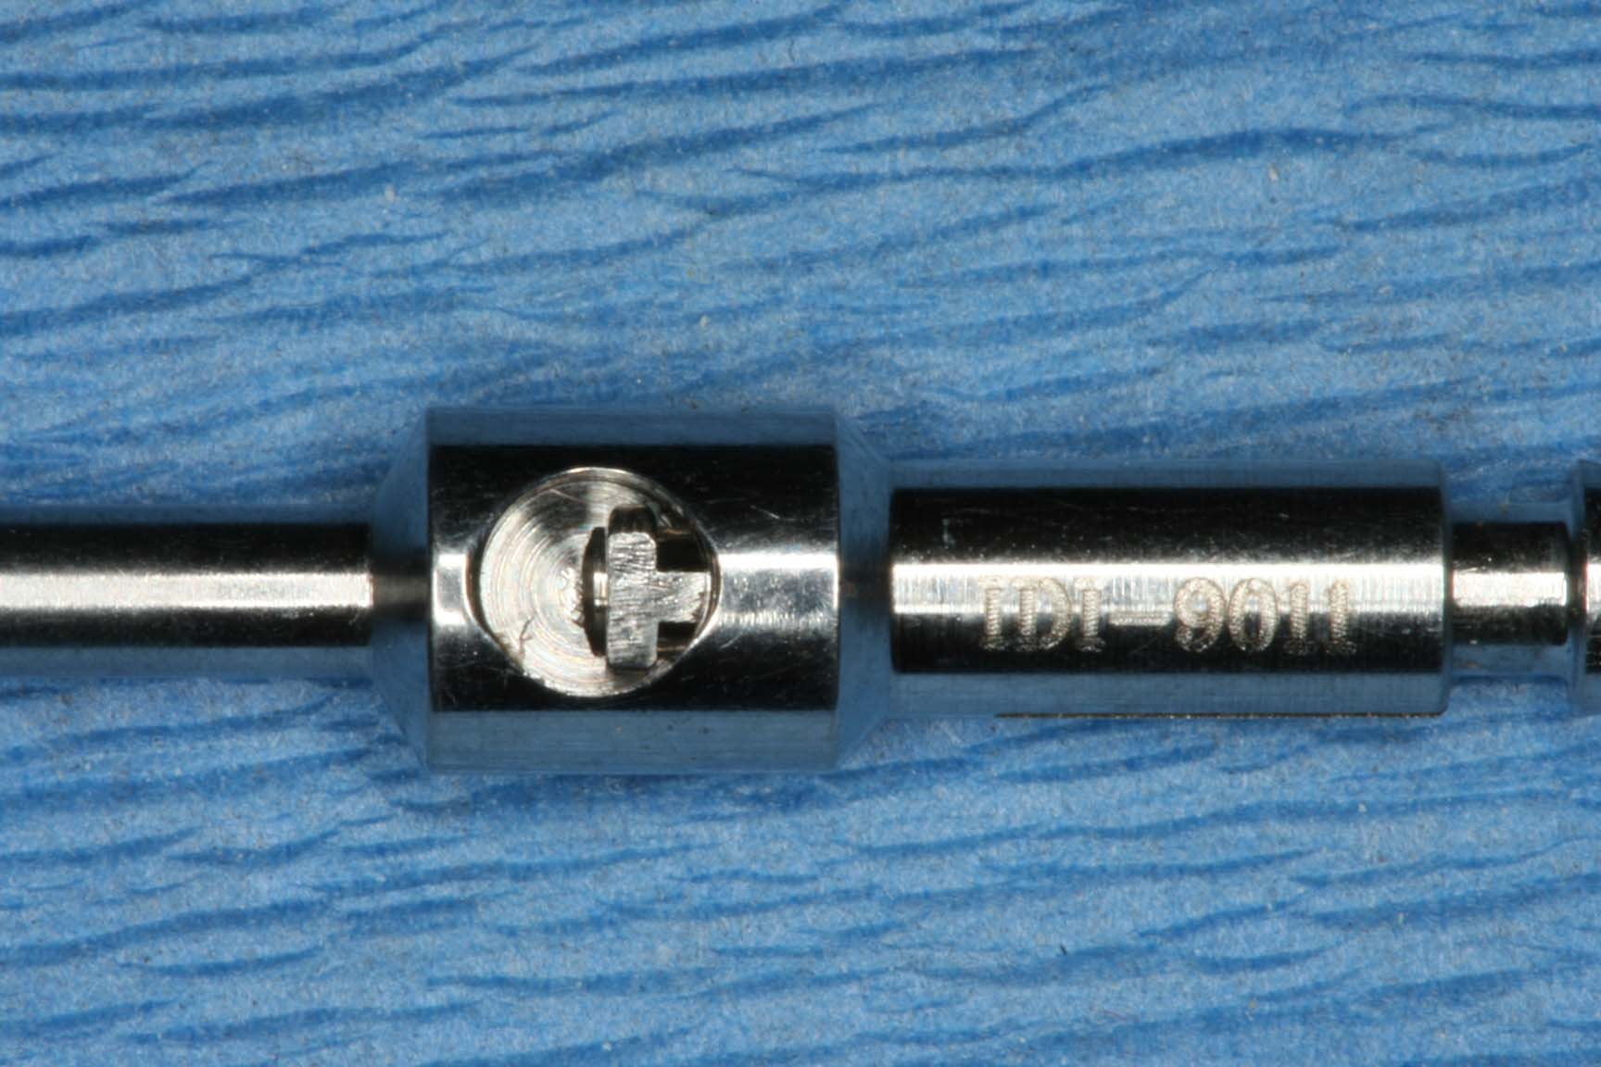
IDI-9011 Drill Extension User’s Manual 正確安裝說明
Step 3
You can see the flat end of the drill seating on semi-circular slot of IDI-9011 Drill Extension via window. (DO NOT twist the drill during and after seating.)
連接完成後，經由鑽頭延長上的圓孔視窗，可以看到鑽頭尾端的平面端，如此才是正確安裝程序。（安裝過程及安裝完成後，請勿轉動鑽頭）
Semi-circular slot
flat end of drill

